Slide 1
High-level Architecture UML Diagrams
Team name: Graduos
Project name: 졸업해줘
Date of doc: 2024/11/17
Version: Final
Team Members
권준호 (2019920003)
김원빈 (2019920016)
정민혁 (2019920048)
채민관 (2019920055)
박정익 (2020920025)
이현제 (2020920051)

Slide 2
High-level Architecture UML Diagrams - Table of Contents -
1. High Level Architecture
2. Class Diagrams for Static View
3. Sequence Diagrams for Dynamic View
4. Archived Diagrams

Slide 3
1. High Level Architecture: Abstract Backend Architecture
Core : Pure business logic without any external dependencies
Infra : Implementation of the components required by the interfaces
* Note that the following dependency graph is structured as a directed acyclic graph (DAG).
core
infra
repository
interfaces
model
others
services
controller

Slide 4
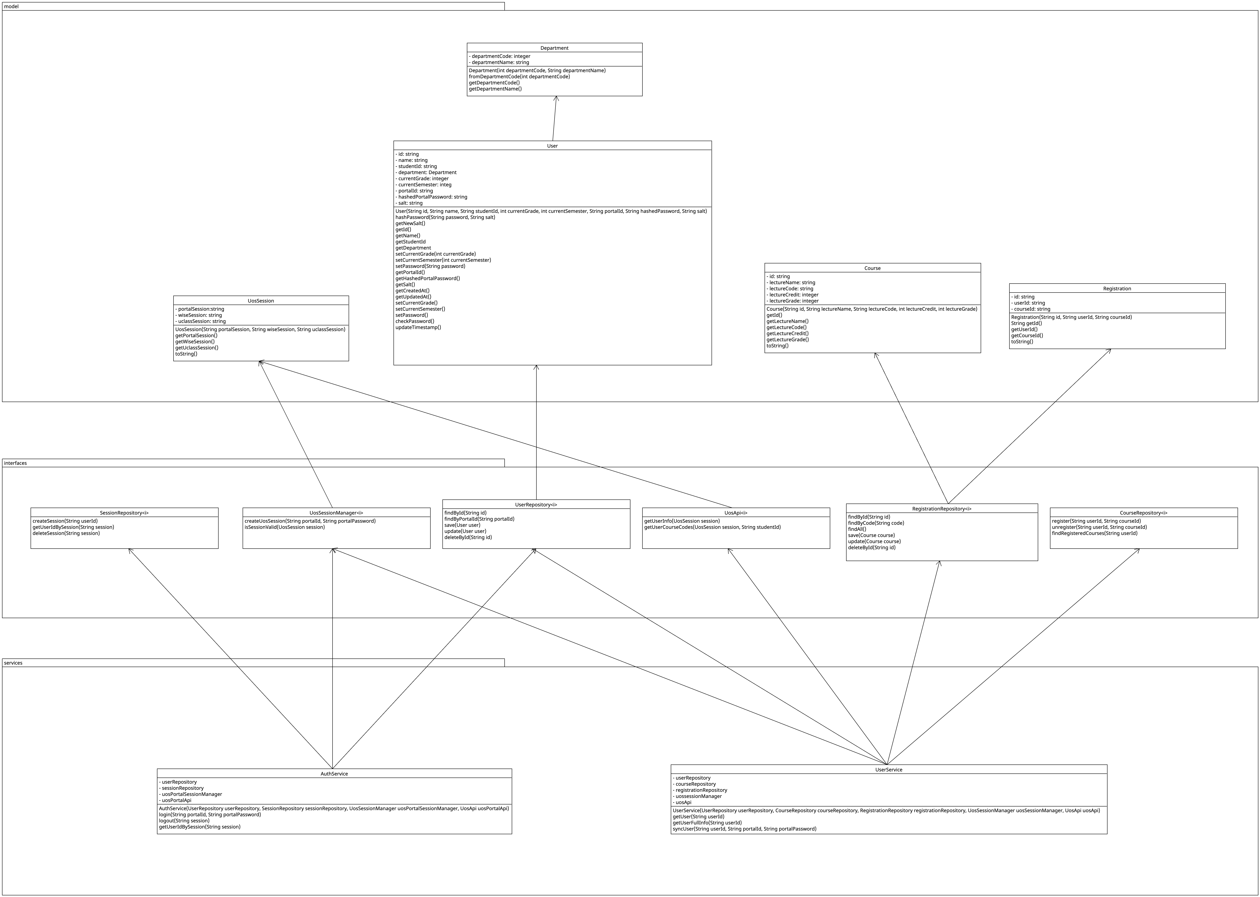
2. Class Diagram for Static View

Slide 5
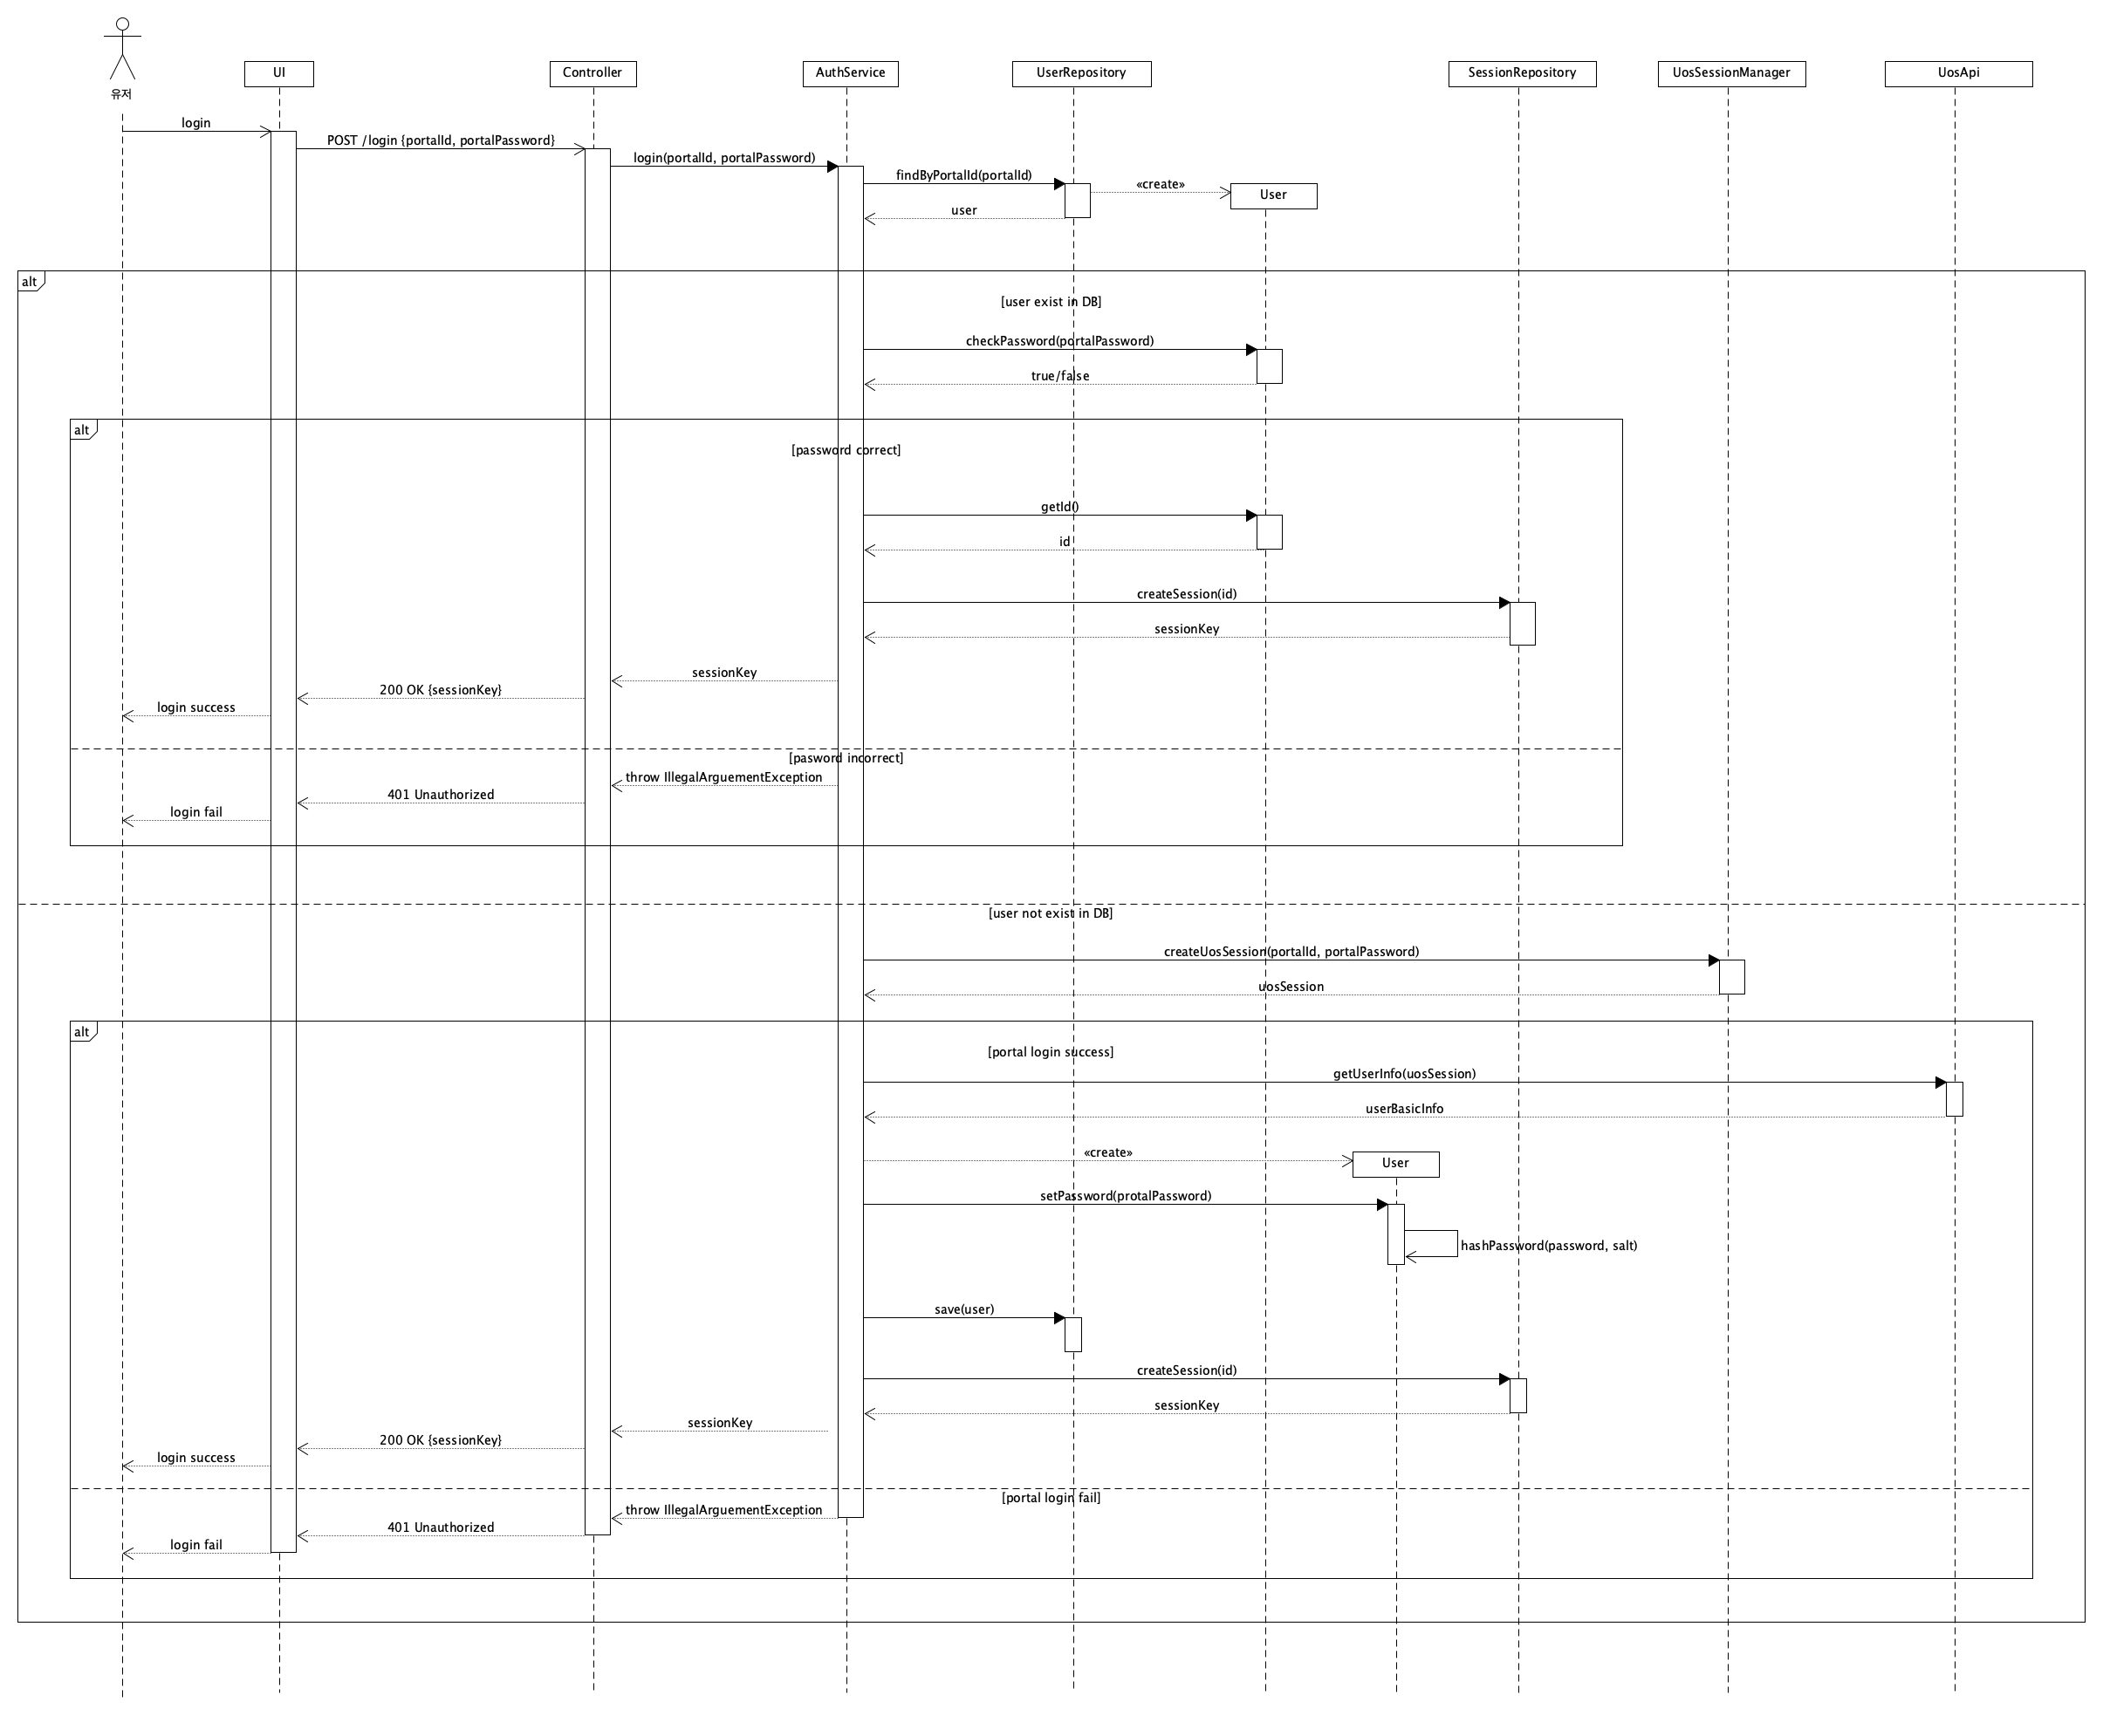
3. Sequence Diagram: UC001
Use case ID: UC001

Slide 6
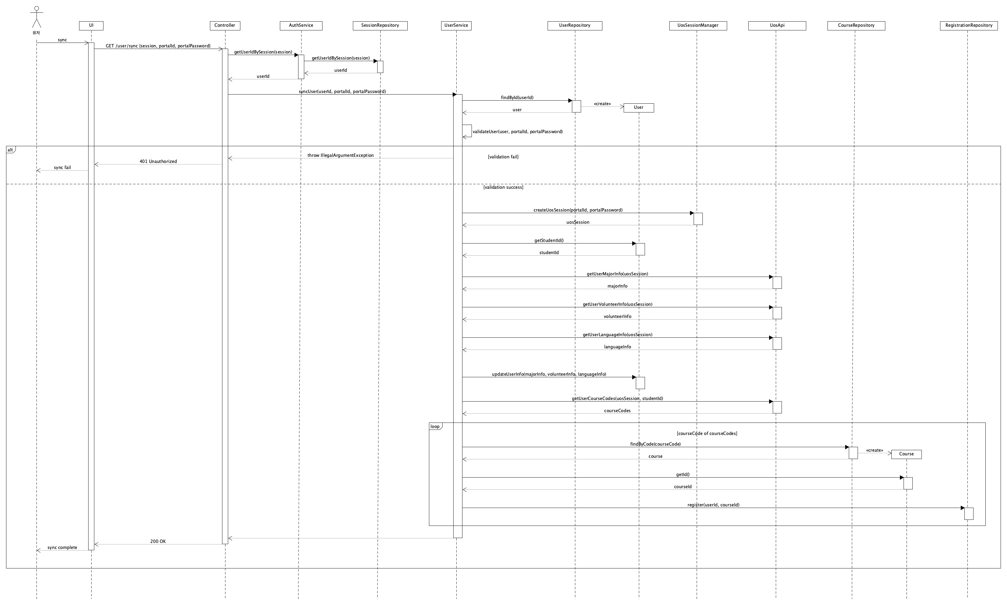
3. Sequence Diagram: UC002
Use case ID: UC002

Slide 7
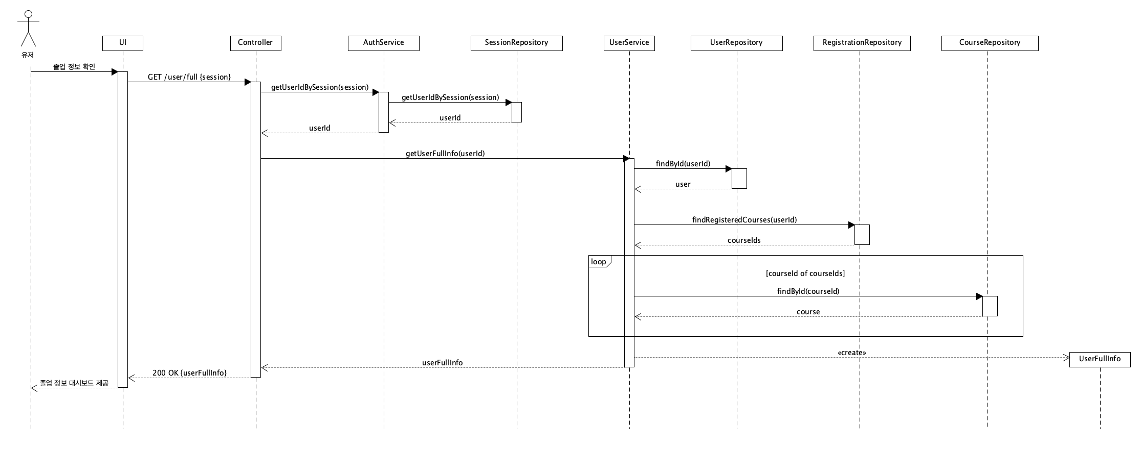
3. Sequence Diagram: UC003
Use case ID: UC003

Slide 8
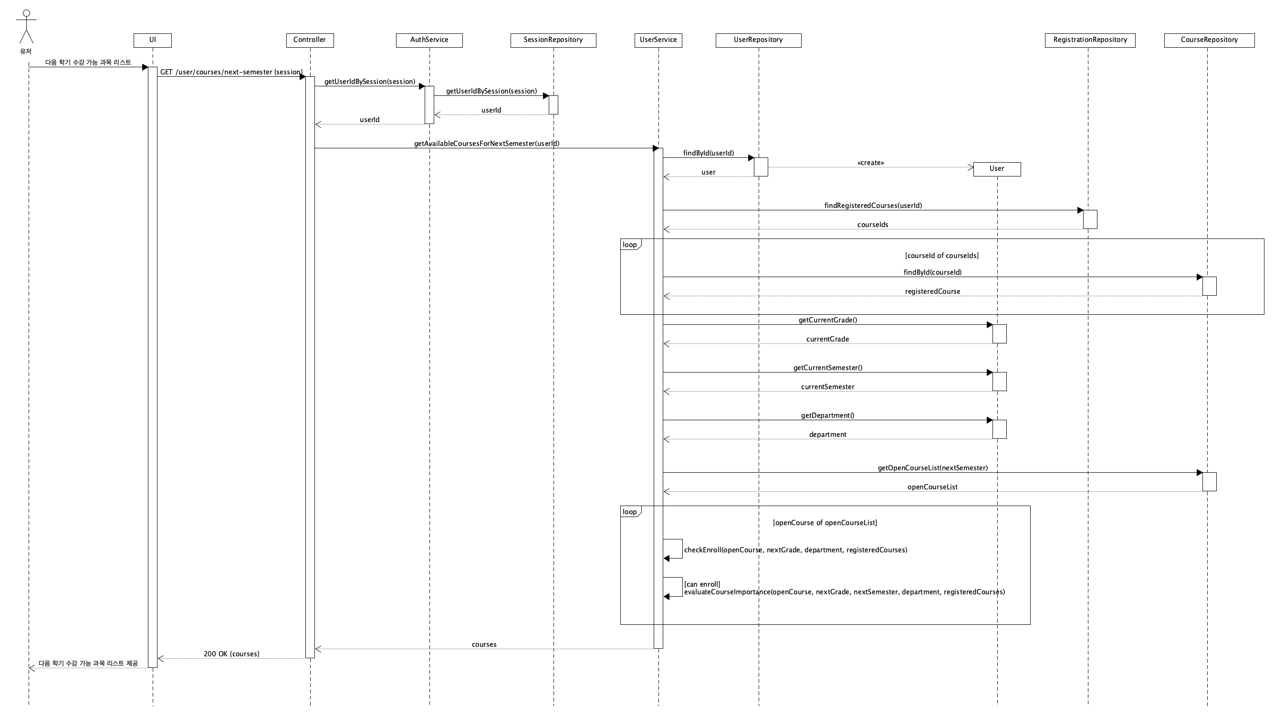
3. Sequence Diagram: UC004
Use case ID: UC004

Slide 9
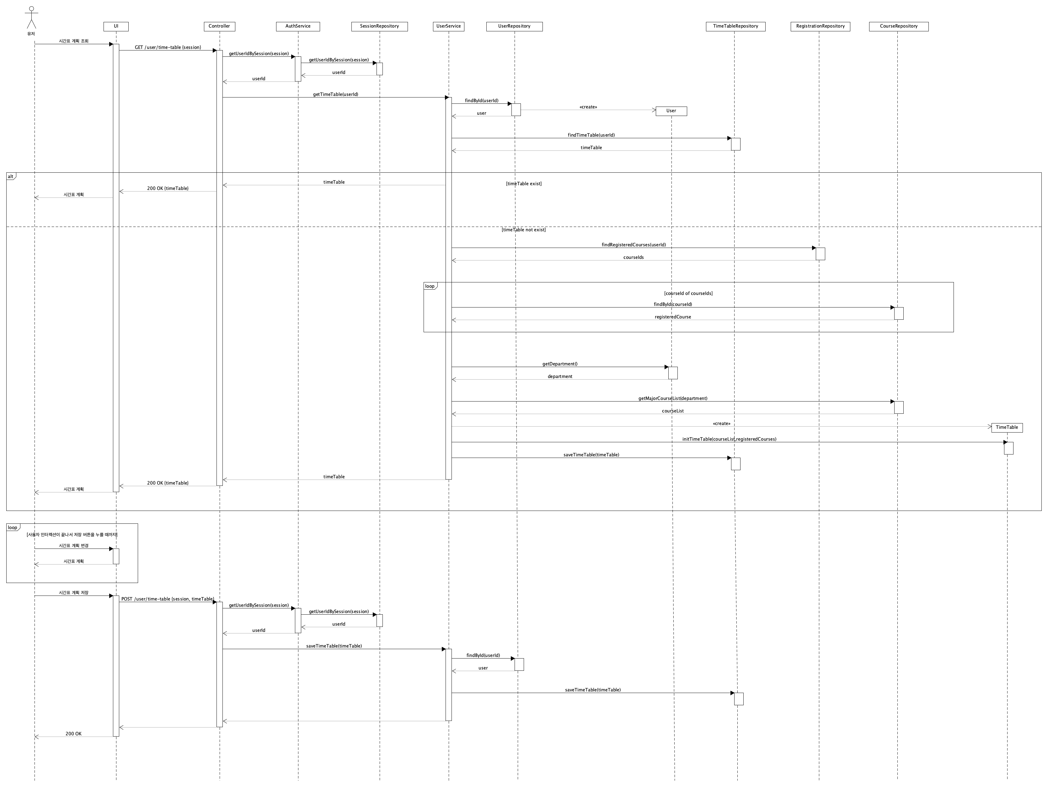
3. Sequence Diagram: UC005
Use case ID: UC005

Slide 10
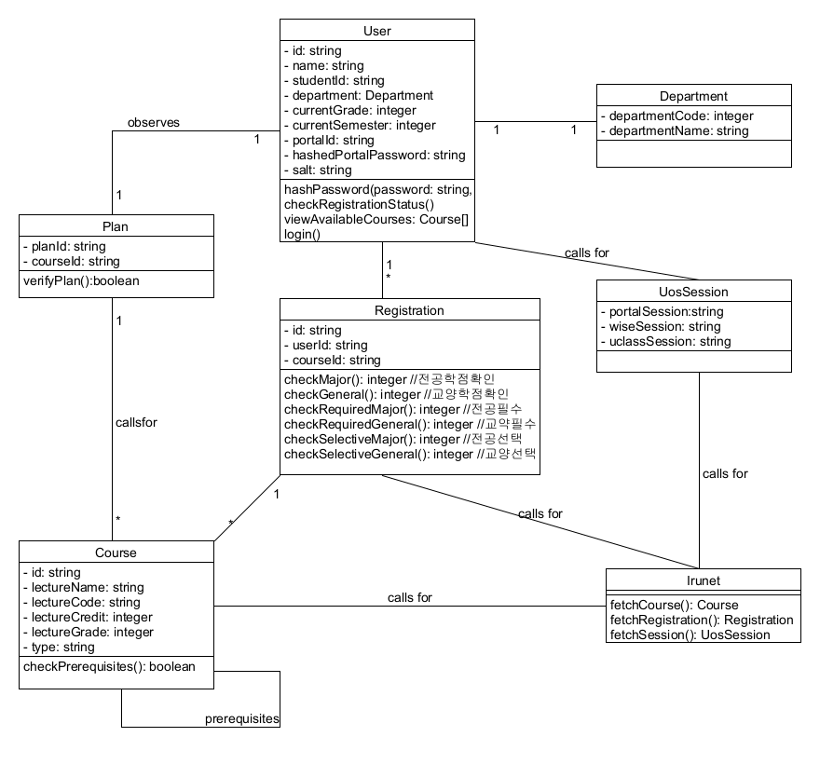
4. Archived Diagram: Class Diagram

Slide 11
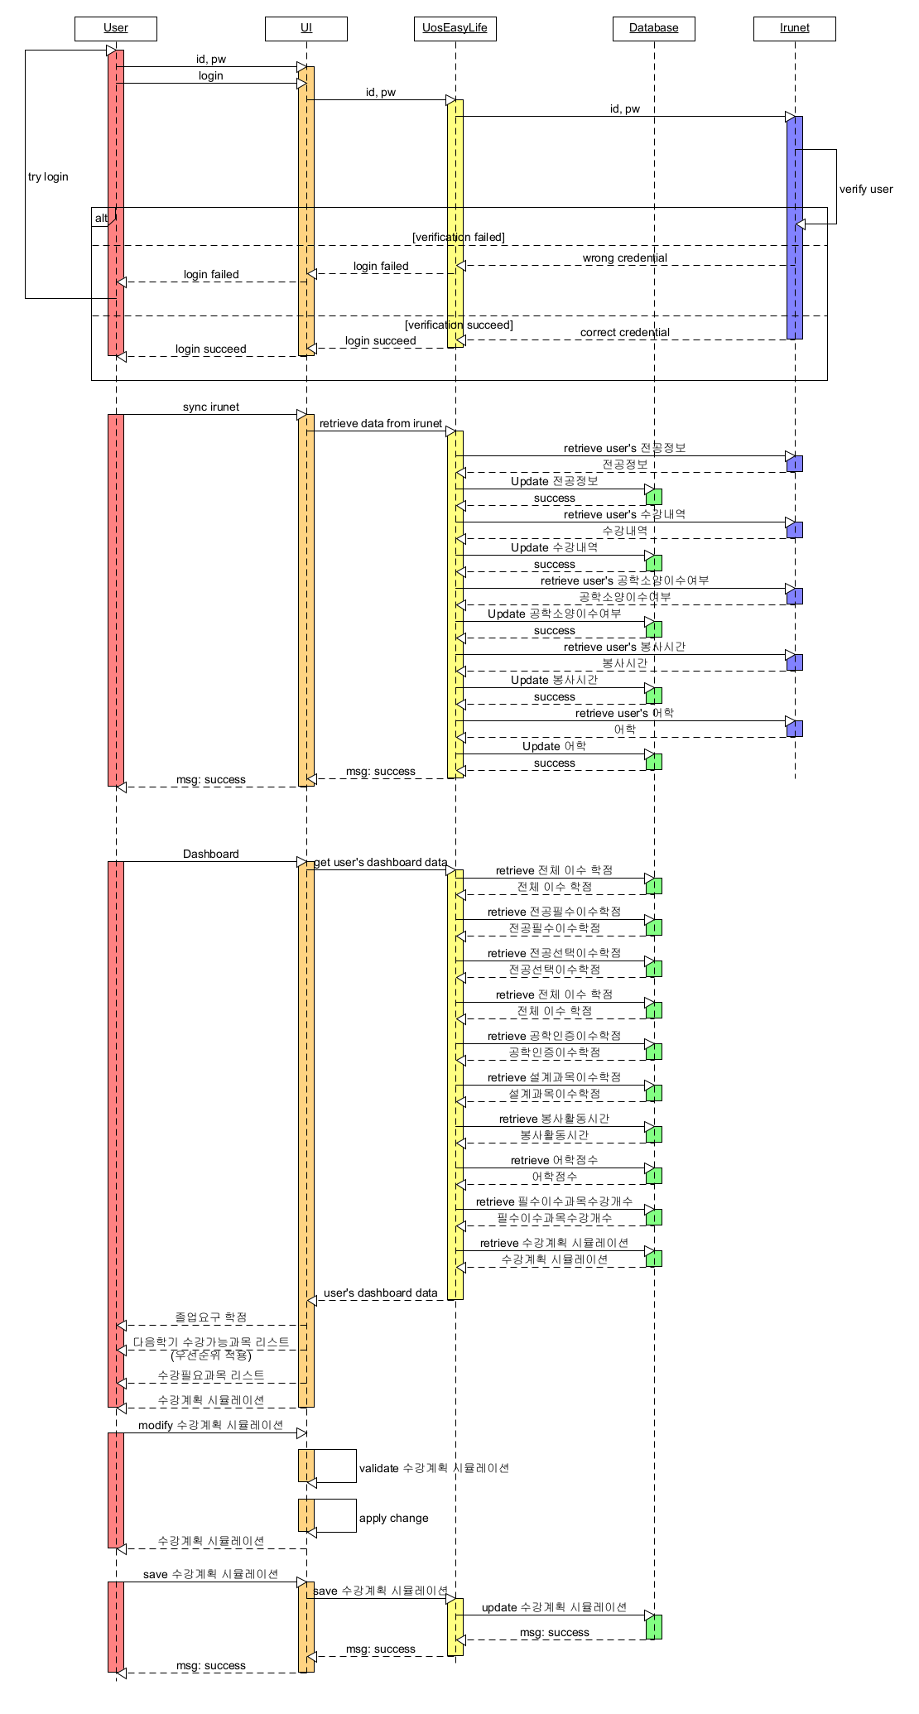
4. Archived Diagram: Sequence Diagram

